Slide 1

Problem Set #2

Slide 2
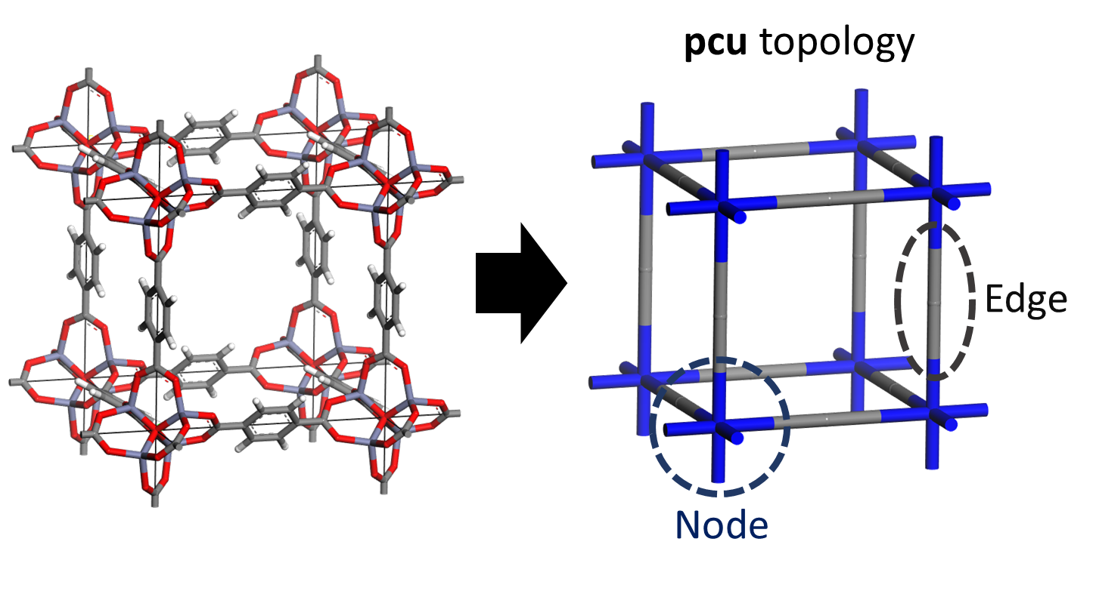
Problem Set #2
In this homework we will predict methane working capacities for MOFs
MOF stands for “Metal-organic framework” and is part of porous materials
Here are short explanations about the data given for the homework_5
MOFs are named after their topology and building blocks(nodes+edge)
Ex) pcu+N127+E134

Slide 3
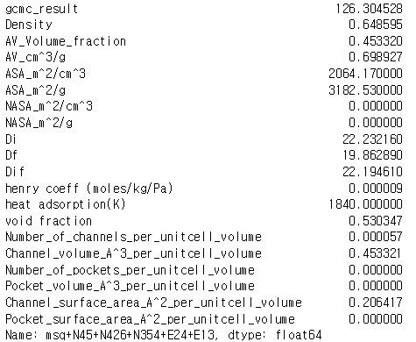

Problem Set #2
In this homework we will use two different representation method for MOFs
First, we will use zeo++ data to represent MOF (part a to c)
Ex) MOF “msq+N45+N426+N354+E24+E13” will be represented as below
Second, we will use constitution data itself to represent MOF (part d)
Ex) MOF “msq+N45+N426+N354+E24+E13” will be represented as
[1882, 3, 1342, 979, 1235, 176]

Slide 4
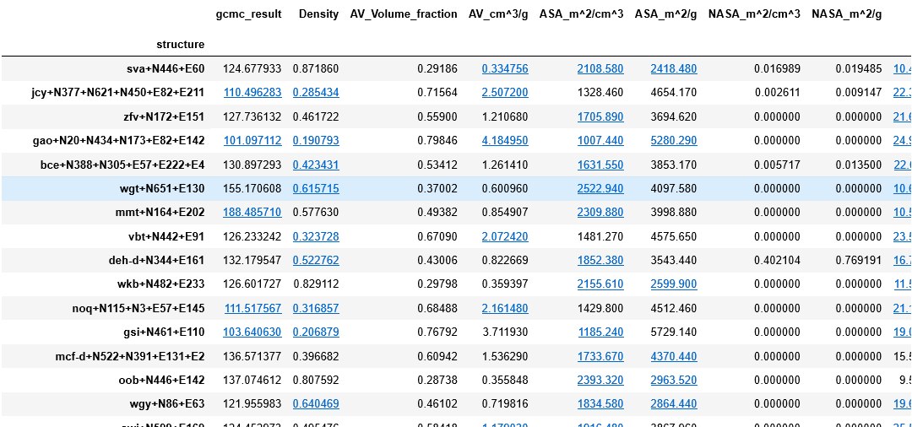
Problem Set #2
First, download “zeo_gcmc_hw5.csv” and “homework5_zeo.ipynb” files uploaded at KLMS and put them in the same folder.
"Zeo_gcmc_hw5.csv”
Will predict working capacity of the material with the feature data
Working capacity data
Features of the material
Material (MOF)
Representation

Slide 5
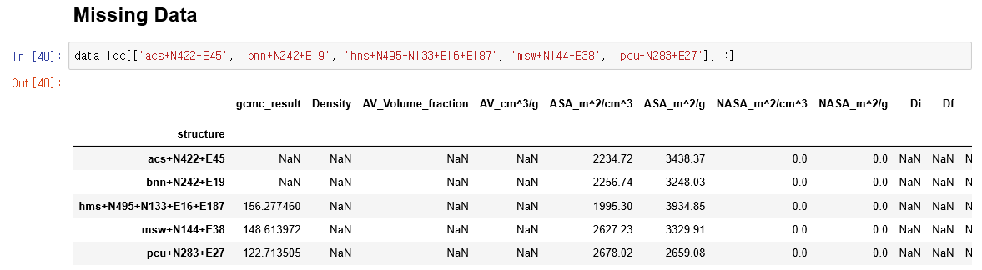
Problem Set #2
Part(a) : you should fill in the missing zeo++ data
Execute “homework5_zeo.ipynb” until “Missing Data” part
Unlike other structures, some of the data for below structures are missed
Missing features are as follows
acs+N422+E45
bnn+N242+E19
hms+N495+N133+E16+E187
msw+N144+E38
pcu+N283+E27
gcmc_result, Density, AV_Volume_fraction, AV_cm^3/g, Di, Df, Dif
Missing data

Slide 6
Problem Set #2
Part(a) : you should fill in the missing zeo++ data
You should run “zeo++” code to get the missing data.
Access putty and add below lines in your .bashrc file (for use of “zeo++”)
In each of your account, we have made a folder Homework5/zeo++
As an example I will do the case for “acs+N422+E45”
# GCC
export GCC=/appl/molsim-gcc/build-5.3.0
export C_INCLUDE_PATH=$GCC/include/c++/5.3.0/
export CPLUS_INCLUDE_PATH=$GCC/include/c++/5.3.0/
export LD_LIBRARY_PATH=$GCC/lib64:$PPL/lib:$LD_LIBRARY_PATH
export PATH=$GCC/bin:$PATH
zeo++ executable code

Slide 7
Problem Set #2
Part(a) : you should fill in the missing zeo++ data
As you can see above I made a ".qsub” file and contents of it is as below
Then submit your qsub file with command “qsub file_name.qsub”
Now, open “.vol” file to get [Density, AV_Volume_fraction, AV_cm^3/g]
and open “.res” file to get [Di, Df, Dif] (they are in order)
#!/bin/bash
#PBS -l nodes=1:batch
#PBS -q batch
cd $PBS_O_WORKDIR
./network -ha -res acs+N422+E45.cif
./network -ha -vol 1.5 1.5 50000 acs+N422+E45.cif

Slide 8
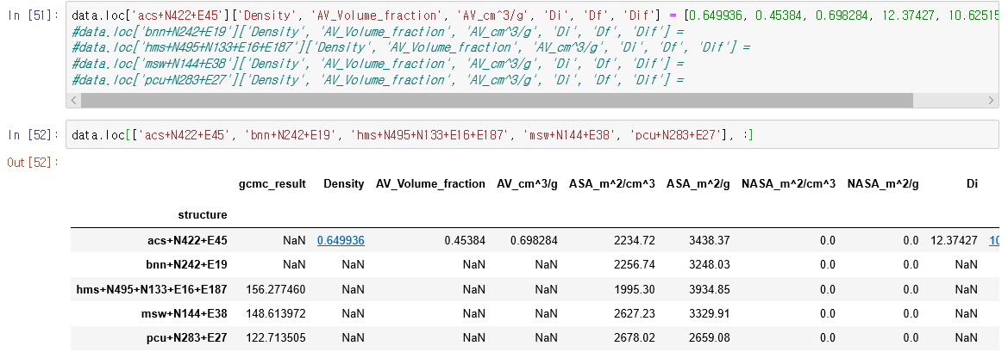
Problem Set #2
Part(a) : you should fill in the missing zeo++ data
As a result I got
[Density, AV_Volume_fraction, AV_cm^3/g, Di, Df, Dif]
= [0.649936, 0.45384, 0.698284, 12.37427, 10.62515, 12.37427]
Get back to your jupyter-notebook to fill in the data
For rest of the structures you should fill in by yourself.

Slide 9
Problem Set #2
Part(b) : you should fill in the missing working capacity data
In previous result, we still miss “gcmc_result” for two structures
To get the values you should conduct RASPA simulation as we did before
Working capacity(CH4) = uptake at 65bar(CH4) – uptake at 5.8bar(CH4)
See lecture 8 for the details of RASPA simulation
(for getting uptake values from output, see slide 30 in lecture 8)

Slide 10
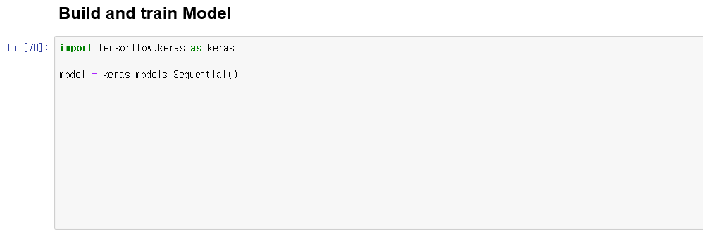
Problem Set #2
Part(c) : Fill in the blanks of “Build and train Model” part
Continue executing “homework5_zeo.ipynb” till “Build and train model” part. Below is where you should fill in.
Execute rest of the “homework5_zeo.ipynb”
Fill in.
A. Build 2 hidden layers (neuron 1000,256)
and 1 output layer
use the activation of “relu” for all layers
B. Compile with optimizer= "adam”, loss = “mse”
and learning rate = 0.0001
C. Train model with train dataset.
Use batch size of 32 and epochs of 4

Slide 11
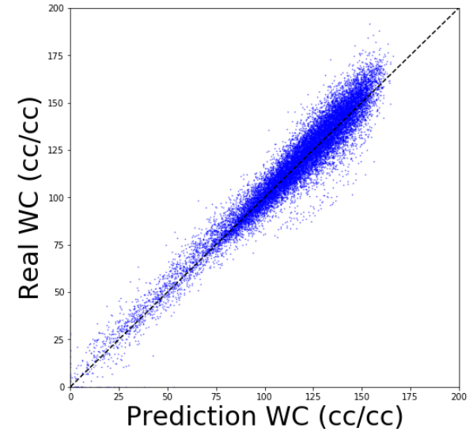
Problem Set #2
If you got the picture below at the end of “homework5_zeo.ipynb”,
you succeeded for part (a) to (c)

Slide 12
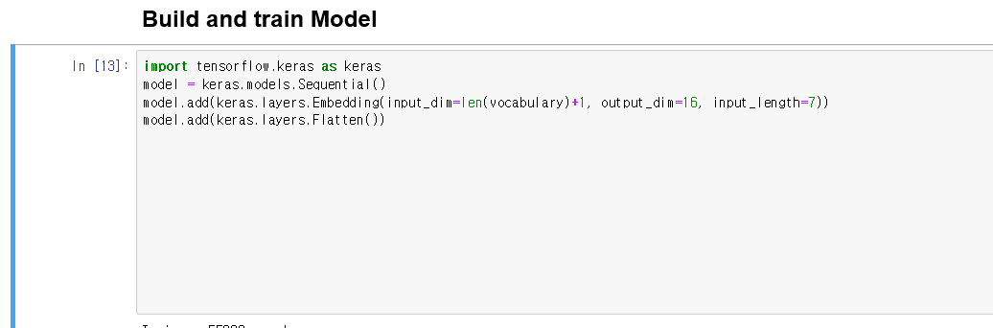
Problem Set #2
Through Part(a) to (c), we predicted WC of MOF with zeo++ data.
In Part(d), we will predict working capacity(CH4) of MOF with different representation method using “topology and constituents”
Download “MOF_wc_data.csv” and “homework5_net.ipynb” files uploaded at KLMS and put them in the same folder.
Execute till “Build and train Model” part
Part(d) : Fill in the blanks of “Build and train Model” of “homework5_net.ipynb”
Fill in.
A. Build 2 hidden layers (neuron 64, 32)
and 1 output layer
use the activation of “relu” for all layers
B. Compile with optimizer= "adam”, loss = “mse”
C. Train model with train dataset.
Use batch size of 32 and epochs of 4

Slide 13
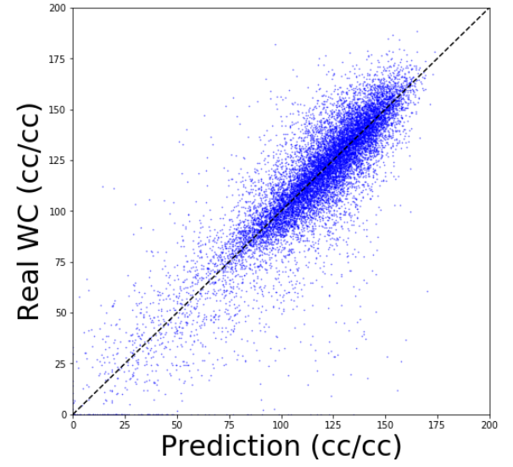
Problem Set #2
If you got the picture below at the end of “homework5_net.ipynb”,
you succeeded for part (d)
make “homework5_zeo.ipynb” and “homework5_net.ipynb” into one “zip” file
Zip file should be named as “hw5_studentID.zip” and hand in through KLMS.

